Slide 1
March 16, 2015
CHRISTOPHER SHEARER
EDUCATION PROGRAM OFFICER

Slide 2
our world is CHANGING

Slide 3
it is growing more COMPLEX
Notes:
Use image of server farm

Slide 4
Manual Clicks
The number of INTERNET DEVICES in was
1984
1992
2008
2014
1,000.
1,000,000.
1,000,000,000.
10,000,000,000.
Notes:
Use image of server farm

Slide 5
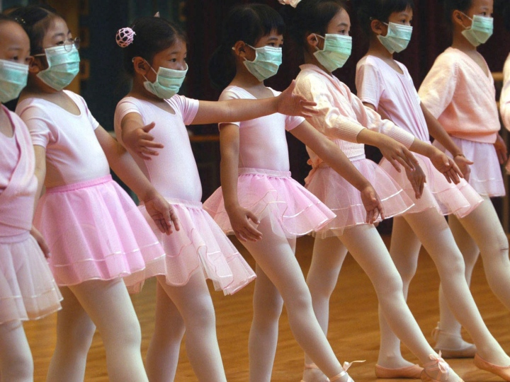
it is growing more RISKY

Slide 6
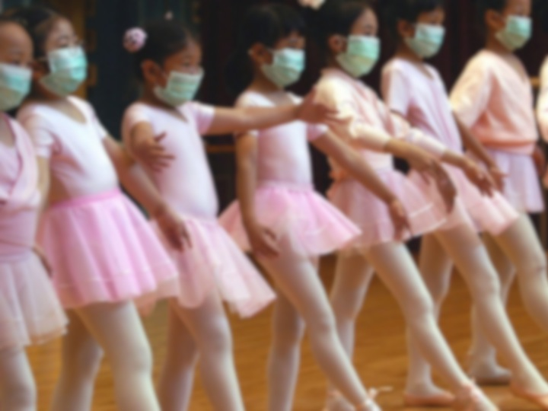
From 1880-2012, THE EARTH’S AVERAGE TEMPERATURE rose 1.5 degrees Fahrenheit.
It will rise 7.2 degrees Fahrenheit by 2100.

Slide 7
it is growing more INTERCONNECTED

Slide 8
It is estimated that A WEEK’S WORTH of the New York Times contains more information than a person was likely to come across in a lifetime in the 18th century.

Slide 9
it is growing more UNEQUAL

Slide 10
In the United States today, THE WEALTHIEST 1% of all Americans have a greater net worth than the bottom 90% combined

Slide 11
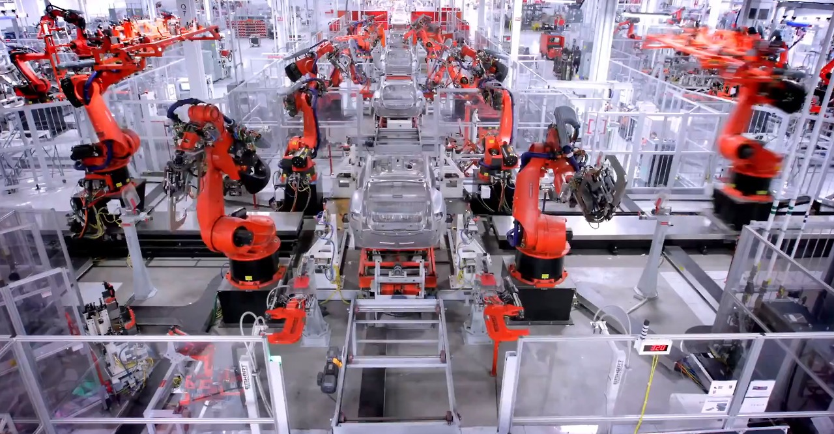
the job market is CHANGING

Slide 12
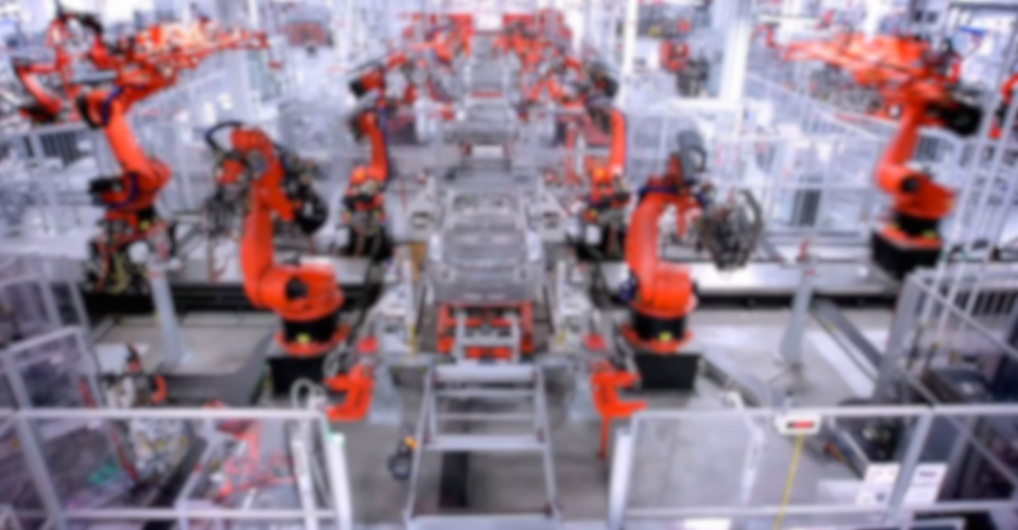
65%
of today’s school-children will eventually be employed in jobs that have yet to be created

Slide 13
Index of Changing Work Tasks in the U.S. Economy 1960 - 2009
Working with New Information
Solving Unstructured Problems
Index Value: 1960 = 50
Routine Manual Tasks
Non-Routine Manual Tasks
Routine Cognitive Tasks
Source: https://therationalpessimist.files.wordpress.com

Slide 14
the job for citizens
is CHANGING
Decisions made by our
children will affect
the future of the planet

Slide 15
Given such CHANGE, when we think about this graduate how do we prepare our children for
A RADICALLY DIFFERENT WORLD?

Slide 16
TEACHABLE
COLLEGE-, CAREER-, & CIVIC-READY
ASSESSABLE

Slide 17
MASTERY
MEANING
MEASUREMENT

Slide 18
Active Learning
Active Listening
Critical Thinking
Learning Strategies
Agreeable
Monitoring
Reading Comprehension
conscientiousness
Speaking
CRITICAL THINKING & PROBLEM SOLVING
Writing
Social Skills
Coordination
Instructing
Negotiation
Persuasion
Service Orientation
Social Perceptiveness
Complex Problem Solving
Technical Skills
Equipment Maintenance
Equipment Selection
Installation
EXPERT COMMUNICATION
Operation Monitoring
Operation and Control
Operations Analysis
Programming
Quality Control Analysis
Repairing
Technology Design
Troubleshooting
System Skills
Judgment and Decision Making
Systems Analysis
Systems Evaluation
Resource Management Skills
Management of Financial Resources
COLLABORATION & TEAMWORK
Management of Material Resources
Management of Personnel Resources
Time Management
Desktop Computer Skills
Spreadsheets
Presentations
Internet
Navigation
Word Processing
Test preparation
Databases
Writes clearly and concisely
speaks effectively
listens attentively
openly expresses ideas
negotiates/resolves differences
leads group discussions
LEARNING TO LEARN
provides feedback
Academic integrity
provides well-thought out solutions
gathers appropriate information
confidently speaks in public
works well with others
sensitive
supportive
motivates others
shares credit
counsels
cooperates
delegates effectively
represents others
understands feelings
self-confident
accepts responsibility
forecasts/predicts
creates ideas
identifies problems
meets goals
identifies resources
gathers information
solves problems
defines needs
analyzes issues
develops strategies
assesses situations
handles details
coordinates tasks
punctual
manages projects effectively
ACADEMIC MINDSETS
meets deadlines
Synonyms & antonyms
keeps control over budget
plans and arranges activities
multi-tasks
leads groups
teaches/trains/instructs
counsels/coaches
manages conflict
delegates responsibility
makes decisions
directs others
implements decisions
enforces policies
takes charge
ACADEMIC CONTENT MASTERY
KEYBOARDING
EXTRAVERSION

Slide 19
Active Learning
Active Listening
Critical Thinking
Learning Strategies
Agreeable
Monitoring
Reading Comprehension
conscientiousness
Speaking
CRITICAL THINKING & PROBLEM SOLVING
Writing
Social Skills
Coordination
Instructing
Negotiation
Persuasion
Service Orientation
Social Perceptiveness
Complex Problem Solving
Technical Skills
Equipment Maintenance
Equipment Selection
Installation
EXPERT COMMUNICATION
Operation Monitoring
Operation and Control
Operations Analysis
Programming
Quality Control Analysis
Repairing
Technology Design
Troubleshooting
System Skills
Judgment and Decision Making
Systems Analysis
Systems Evaluation
Resource Management Skills
Management of Financial Resources
COLLABORATION & TEAMWORK
Management of Material Resources
Management of Personnel Resources
Time Management
Desktop Computer Skills
Spreadsheets
Presentations
Internet
Navigation
Word Processing
Test preparation
Databases
Writes clearly and concisely
speaks effectively
listens attentively
openly expresses ideas
negotiates/resolves differences
leads group discussions
LEARNING TO LEARN
provides feedback
Academic integrity
provides well-thought out solutions
gathers appropriate information
confidently speaks in public
works well with others
sensitive
supportive
motivates others
shares credit
counsels
cooperates
delegates effectively
represents others
understands feelings
self-confident
accepts responsibility
forecasts/predicts
creates ideas
identifies problems
meets goals
identifies resources
gathers information
solves problems
defines needs
analyzes issues
develops strategies
assesses situations
handles details
coordinates tasks
punctual
manages projects effectively
ACADEMIC MINDSETS
meets deadlines
Synonyms & antonyms
keeps control over budget
plans and arranges activities
multi-tasks
leads groups
teaches/trains/instructs
counsels/coaches
manages conflict
delegates responsibility
makes decisions
directs others
implements decisions
enforces policies
takes charge
ACADEMIC CONTENT MASTERY
KEYBOARDING
EXTRAVERSION

Slide 20
MEANING
Active Learning
Active Listening
Critical Thinking
Learning Strategies
agreeable
Monitoring
Reading Comprehension
conscientiousness
Speaking
CRITICAL THINKING & PROBLEM SOLVING
Writing
Social Skills
Coordination
Instructing
Negotiation
Persuasion
Service Orientation
Social Perceptiveness
Complex Problem Solving
Technical Skills
Equipment Maintenance
Equipment Selection
Installation
EXPERT COMMUNICATION
Operation Monitoring
Operation and Control
Operations Analysis
Programming
Quality Control Analysis
Repairing
Technology Design
Troubleshooting
System Skills
Judgment and Decision Making
Systems Analysis
Systems Evaluation
Resource Management Skills
Management of Financial Resources
COLLABORATION & TEAMWORK
Management of Material Resources
Management of Personnel Resources
Time Management
Desktop Computer Skills
Spreadsheets
Presentations
Internet
Navigation
Word Processing
Test preparation
Databases
Writes clearly and concisely
speaks effectively
listens attentively
openly expresses ideas
negotiates/resolves differences
leads group discussions
LEARNING TO LEARN
provides feedback
Academic integrity
provides well-thought out solutions
gathers appropriate information
confidently speaks in public
works well with others
sensitive
supportive
motivates others
shares credit
counsels
cooperates
delegates effectively
represents others
understands feelings
self-confident
accepts responsibility
forecasts/predicts
creates ideas
identifies problems
meets goals
identifies resources
gathers information
solves problems
defines needs
analyzes issues
develops strategies
assesses situations
handles details
coordinates tasks
punctual
manages projects effectively
ACADEMIC MINDSETS
meets deadlines
Synonyms & antonyms
keeps control over budget
plans and arranges activities
multi-tasks
leads groups
teaches/trains/instructs
counsels/coaches
manages conflict
delegates responsibility
makes decisions
directs others
implements decisions
enforces policies
takes charge
ACADEMIC CONTENT MASTERY
KEYBOARDING
EXTRAVERSION

Slide 21
MEANING
Active Learning
Active Listening
Critical Thinking
Learning Strategies
agreeable
Monitoring
Reading Comprehension
conscientiousness
Speaking
CRITICAL THINKING & PROBLEM SOLVING
Writing
Social Skills
Coordination
Instructing
Negotiation
Persuasion
Service Orientation
Social Perceptiveness
Complex Problem Solving
Technical Skills
Equipment Maintenance
Equipment Selection
Installation
EXPERT COMMUNICATION
Operation Monitoring
Operation and Control
Operations Analysis
Programming
Quality Control Analysis
Repairing
Technology Design
Troubleshooting
System Skills
Judgment and Decision Making
Systems Analysis
Systems Evaluation
Resource Management Skills
Management of Financial Resources
COLLABORATION & TEAMWORK
Management of Material Resources
Management of Personnel Resources
Time Management
Desktop Computer Skills
Spreadsheets
Presentations
Internet
Navigation
Word Processing
Test preparation
Databases
Writes clearly and concisely
speaks effectively
listens attentively
openly expresses ideas
negotiates/resolves differences
leads group discussions
LEARNING TO LEARN
provides feedback
Academic integrity
provides well-thought out solutions
gathers appropriate information
confidently speaks in public
works well with others
sensitive
supportive
motivates others
shares credit
counsels
cooperates
delegates effectively
represents others
understands feelings
self-confident
accepts responsibility
forecasts/predicts
creates ideas
identifies problems
meets goals
identifies resources
gathers information
solves problems
defines needs
analyzes issues
develops strategies
assesses situations
handles details
coordinates tasks
punctual
manages projects effectively
ACADEMIC MINDSETS
meets deadlines
Synonyms & antonyms
keeps control over budget
plans and arranges activities
multi-tasks
leads groups
teaches/trains/instructs
counsels/coaches
manages conflict
delegates responsibility
makes decisions
directs others
implements decisions
enforces policies
takes charge
ACADEMIC CONTENT MASTERY
KEYBOARDING
EXTRAVERSION

Slide 22
meaning
MASTERY
Active Learning
Active Listening
Critical Thinking
Learning Strategies
agreeable
Monitoring
Reading Comprehension
conscientiousness
Speaking
CRITICAL THINKING & PROBLEM SOLVING
Writing
Social Skills
Coordination
Instructing
Negotiation
Persuasion
Service Orientation
Social Perceptiveness
Complex Problem Solving
Technical Skills
Equipment Maintenance
Equipment Selection
Installation
EXPERT COMMUNICATION
Operation Monitoring
Operation and Control
Operations Analysis
Programming
Quality Control Analysis
Repairing
Technology Design
Troubleshooting
System Skills
Judgment and Decision Making
Systems Analysis
Systems Evaluation
Resource Management Skills
Management of Financial Resources
COLLABORATION & TEAMWORK
Management of Material Resources
Management of Personnel Resources
Time Management
Desktop Computer Skills
Spreadsheets
Presentations
Internet
Navigation
Word Processing
Test preparation
Databases
Writes clearly and concisely
speaks effectively
listens attentively
openly expresses ideas
negotiates/resolves differences
leads group discussions
LEARNING TO LEARN
provides feedback
Academic integrity
provides well-thought out solutions
gathers appropriate information
confidently speaks in public
works well with others
sensitive
supportive
motivates others
shares credit
counsels
cooperates
delegates effectively
represents others
understands feelings
self-confident
accepts responsibility
forecasts/predicts
creates ideas
identifies problems
meets goals
identifies resources
gathers information
solves problems
defines needs
analyzes issues
develops strategies
assesses situations
handles details
coordinates tasks
punctual
manages projects effectively
ACADEMIC MINDSETS
meets deadlines
Synonyms & antonyms
keeps control over budget
plans and arranges activities
multi-tasks
leads groups
teaches/trains/instructs
counsels/coaches
manages conflict
delegates responsibility
makes decisions
directs others
implements decisions
enforces policies
takes charge
ACADEMIC CONTENT MASTERY
KEYBOARDING
EXTRAVERSION

Slide 23
meaning
MASTERY
Active Learning
Active Listening
Critical Thinking
Learning Strategies
agreeable
Monitoring
Reading Comprehension
conscientiousness
Speaking
CRITICAL THINKING & PROBLEM SOLVING
Writing
Social Skills
Coordination
Instructing
Negotiation
Persuasion
Service Orientation
Social Perceptiveness
Complex Problem Solving
Technical Skills
Equipment Maintenance
Equipment Selection
Installation
EXPERT COMMUNICATION
Operation Monitoring
Operation and Control
Operations Analysis
Programming
Quality Control Analysis
Repairing
Technology Design
Troubleshooting
System Skills
Judgment and Decision Making
Systems Analysis
Systems Evaluation
Resource Management Skills
Management of Financial Resources
COLLABORATION & TEAMWORK
Management of Material Resources
Management of Personnel Resources
Time Management
Desktop Computer Skills
Spreadsheets
Presentations
Internet
Navigation
Word Processing
Test preparation
Databases
Writes clearly and concisely
speaks effectively
listens attentively
openly expresses ideas
negotiates/resolves differences
leads group discussions
LEARNING TO LEARN
provides feedback
Academic integrity
provides well-thought out solutions
gathers appropriate information
confidently speaks in public
works well with others
sensitive
supportive
motivates others
shares credit
counsels
cooperates
delegates effectively
represents others
understands feelings
self-confident
accepts responsibility
forecasts/predicts
creates ideas
identifies problems
meets goals
identifies resources
gathers information
solves problems
defines needs
analyzes issues
develops strategies
assesses situations
handles details
coordinates tasks
punctual
manages projects effectively
ACADEMIC MINDSETS
meets deadlines
Synonyms & antonyms
keeps control over budget
plans and arranges activities
multi-tasks
leads groups
teaches/trains/instructs
counsels/coaches
manages conflict
delegates responsibility
makes decisions
directs others
implements decisions
enforces policies
takes charge
ACADEMIC CONTENT MASTERY
KEYBOARDING
EXTRAVERSION

Slide 24
meaningful
malleable
meaning
mastery
MEASUREMENT
Deeper Learning
ACADEMIC MINDSETS
CRITICAL THINKING & PROBLEM SOLVING
COLLABORATION & TEAMWORK
applied to
ACADEMIC CONTENT MASTERY
EXPERT COMMUNICATION
LEARNING TO LEARN

Slide 25
Meaning

Slide 26
Mastery
POLARIS SCHOOL

Slide 27
Measurement

Slide 28
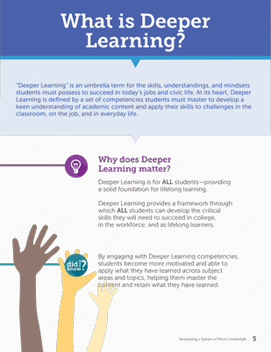
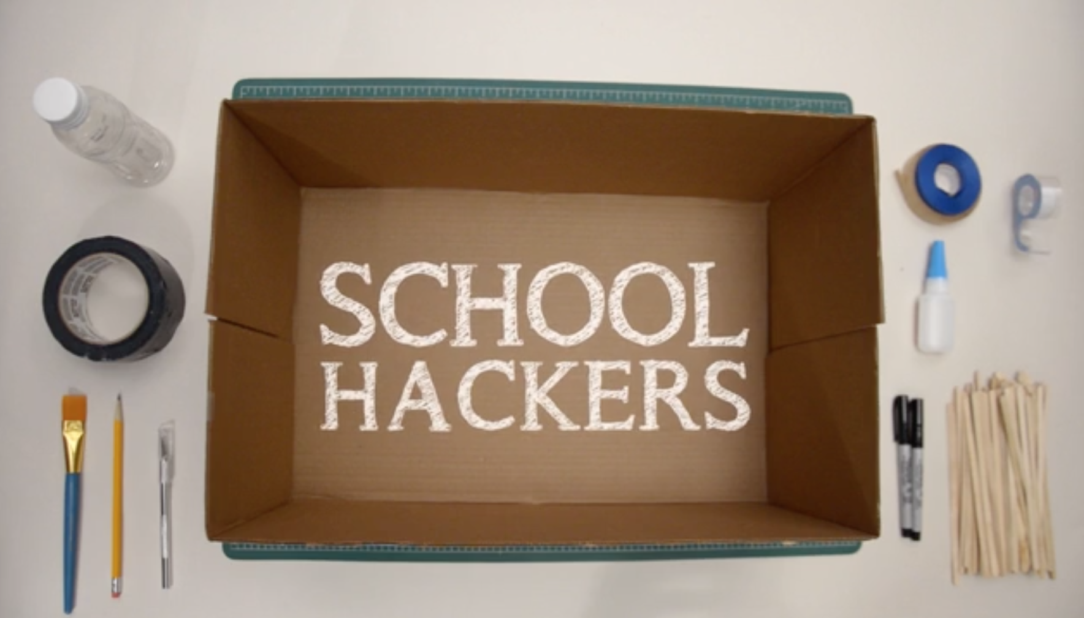
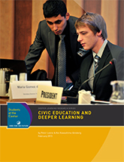
resources
FOR TEACHERS
FOR TEACHERS
Teaching Channel Videos https://www.teachingchannel.org/deeper-learning-video-series
Monica Martinez Book & Practitioners Guide http://www.amazon.com/Deeper-Learning-Innovative-Transforming-Twenty-First/dp/1595589597
Digital Promise Micro-credentials http://www.digitalpromise.org/blog/entry/supporting-deeper-learning-in-the-classroom
High Tech High Conference http://www.deeper-learning.org/dl2015/
School Hackers http://www.businessinnovationfactory.com/projects/student/portfolio/school-hackers
FOR ADMINISTRATORS
School Retool http://www.schoolretool.org/about
EdLeader 21 http://www.edleader21.com/
FOR POLICYMAKERS
Education for Life and Work http://www.nap.edu/catalog/13398/education-for-life-and-work-developing-transferable-knowledge-and-skills
Jobs for the Future Deeper Learning Series http://www.jff.org/initiatives/students-center/what-deeper-learning
AIR study http://www.air.org/project/study-deeper-learning-opportunities-and-outcomes
Alliance for Excellent Education http://deeperlearning4all.org/
CCSSO Innovation Lab Network http://www.ccsso.org/What_We_Do/Innovation_Lab_Network.html
Teaching Channel Videos
Monica Martinez Book
Digital Promise Micro-credentials
High Tech High Conference
School Hackers
https://www.teachingchannel.org/deeper-learning-video-series
http://www.amazon.com/Deeper-Learning-Innovative-Transforming-Twenty-First/dp/1595589597
http://www.digitalpromise.org/blog/entry/supporting-deeper-learning-in-the-classroom
http://www.deeper-learning.org/dl2015/
http://www.businessinnovationfactory.com/projects/student/portfolio/school-hackers
FOR ADMINISTRATORS
School Retool
EdLeader 21
Monica Martinez Practitioner’s Guide
AIR study
http://www.schoolretool.org/about
http://www.edleader21.com/
www.DLPlanningGuide.com
http://www.air.org/project/study-deeper-learning-opportunities-and-outcomes
FOR POLICYMAKERS
Education for Life and Work
Jobs for the Future Deeper Learning Series
National Commission on Teaching & America’s Future
Alliance for Excellent Education
CCSSO Innovation Lab Network
http://www.nap.edu/catalog/13398/education-for-life-and-work-developing-transferable-knowledge-and-skills
http://www.jff.org/initiatives/students-center/what-deeper-learning
http://nctaf.org
http://deeperlearning4all.org/
http://www.ccsso.org/What_We_Do/Innovation_Lab_Network.html

Slide 29
take action
VISIT A DEEPER LEARNING SCHOOL
http://www.hewlett.org/programs/education/deeper-learning/more-resources
VISIT A DEEPER LEARNING SCHOOL
http://www.hewlett.org/programs/education/deeper-learning/more-resources
TAKE A LOOK AT A DEEPER LEARNING RESOURCE
BECOME A DEEPER LEARNING CHAMPION
Use social media to communicate about deeper learning #deeper learning
Talk to school administrators about deeper learning
Try a big idea from School Retool http://www.schoolretool.org/big-ideas
TAKE A LOOK AT A DEEPER LEARNING RESOURCE
http://www.jff.org/initiatives/students-center/what-deeper-learning
BECOME A DEEPER LEARNING CHAMPION
COMMUNICATE
INQUIRE
TRY IT OUT !
#deeperlearning
http://www.edleader21.com/
http://www.schoolretool.org/big-ideas
http://blogs.edweek.org/edweek/learning_deeply/

Slide 30
March 16, 2015
Questions?
Implications?
Discussion?
#deeperlearning

