Slide 1
City Partnership
Los Angeles Unified School District
and
City of Los Angeles
Economic and Workforce Development Department

Slide 2
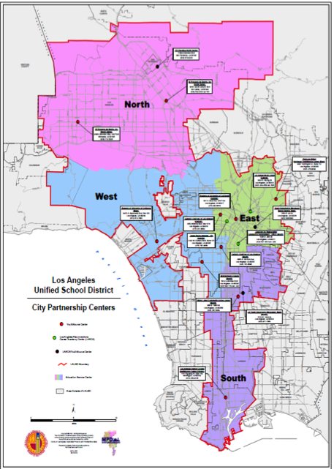
City Partnership
13 Youth Source Centers
Shared funding for PSA Services
50% LAUSD
50% City of Los Angeles
3 LARCA Sites
PSA Counselors are 100% Funded by WIF monies

Slide 3
Pupil Services and Attendance Counselor: Education and Experience
Master’s Degree in Social Work, School Counseling, Education
Pupil Personnel Services Credential specializing in Child Welfare and Attendance
Registered with the Board of Behavioral Sciences as a Licensed Clinician or on track to become Licensed
Extensive experience working with high risk students
Experts in interpreting laws and bulletins related to education, enrollment, attendance policies and pupil records.

Slide 4
City Partnership PSA Counselors
Co-located in YouthSource Centers and Community Agencies
Many placed in the communities that they previously served
Minimum of 6 years experience serving LAUSD students.
Backgrounds in academic counseling, dropout recovery, teaching and DCFS.

Slide 5
PSA Counselor Responsibilities: Services
Outreach
Direct Services
Educational and Psychosocial Assessments
Case Management
Training
Integration with LAUSD Departments

Slide 6
YouthSource Services
Youth Employment Services for youth age 16-21
Work Readiness Training
Internships
Job Placement
Cash for College
Financial assistance to complete educational goals
G.E.D.
Adult Education Courses

Slide 7
Data
2012-2013
5,394 Educational Assessments by PSA Counselor
2,910 enrolled in Youth Source System
972 high school dropouts were returned to school
2013-2014
2,880 Educational Assessments as of 1/31/14

Slide 8
Truancy Diversion Program (TDP) Overview
Community Members and Activist demanded:
End to the School to Prison Pipeline
“Counselors not tickets’
Daytime Curfew Law Amended
Juvenile Courts Closed
Resulted in:
LASPD and Pupil Services Partnership

Slide 9
Goal of Truancy Diversion
Provide meaningful interventions to students that have violated the Daytime Curfew Law and their families
Identify root causes
Conduct educational and psychosocial assessments
Engage parents/students in an off-campus environment
Educate parents/students regarding laws, options, benefits of school attendance
Encourage parents/students to take advantage
of resources

Slide 10
Arrest Diversion Program
Ongoing demand to end criminalizing of our students
Aligned with Board Resolution School Discipline Policy and School Climate Bill of Rights authored by School Board Member Monica Garcia
Alternative to minor infractions including: battery, fights, possession of marijuana under an ounce
Needs of student, victim and school community are met
Repair trust between school district and community

Slide 11
Additional Grants/Resources
Field Education Program
Youth Service Professionals’ Knowledge, Skills, and Abilities Professional Development Grant (Department of Labor)
Notes:
10 USC interns providing individual and group counseling to help supplement and serve the mental health needs of our youth
We are always finding way to support the professional development of everyone in the partnership. Our recently awarded grant will provide case mangers, career coaches and PSA Counselors with more in depth training on:
Knowledge of the Field: This Work We Do
Assessment & Individualized Planning: Charting a Course with Youth
Career Preparation & Exploration: Youth Opening the Door to the World of Work
Community Resources: Weaving a Web for Youth

Slide 12
Opportunity Youth Incentive Fund
Serve most vulnerable population:
Foster Youth
Develop multi-agency system:
LAUSD, City of Los Angeles, County of Los Angeles, Community College District, Community Agencies, DCFS
Address the high dropout rate amongst this group:
Provide opportunities and pathways that integrates education and work experience and lead to career credential
Notes:
In 2013 we applied for a grant where we would be able to serve one of our most vulnerable populations: Foster youth
This grant required bureaucracies to serve these youth together and eliminate working in silos.
It required: LAUSD, City of Los Angles, County of Los Angles, Community College District, Community Agencies and DCFS to sit at the table and develop a plan.
They needed to address the high dropout rate amongst this group.
Utilizing the current youth source system as a model we are identifying other ways of expanding and provide these youth with:
Opportunities and pathways that integrates education and work experiences and
Lead to a career credential

Slide 13
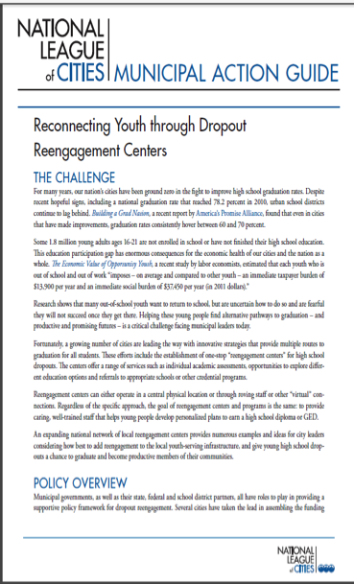
National Model
Recognized by the U.S. Department of Education and Los Angeles Mayor Eric Garcetti
Recognized at the National Re-Engagement Plus Convening December 11-13, 2013
150 experts from 22 cities across the U.S. came to share best practices
Municipal Action Guide highlights City Partnership as a model for “taking the lead in developing a dropout reengagement strategy”

Slide 14
Notes:
Most importantly we highlight the stories of the students we serve.
This also reminds us that we are in this together and changing the trajectory of so many lives

