Slide 1
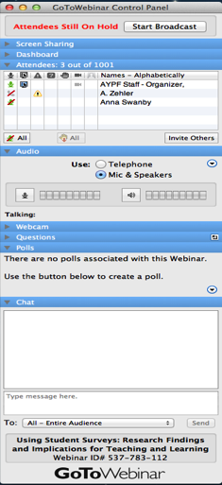
Webinar Technical Support
GoToWebinar Technical Assistance: 1-800-263-6317
To submit live questions, please use the “Questions” box
A recording of the webinar and other resources will be available at www.aypf.org

Slide 2
Introduction: Tripod Student Surveys and School Improvement Rob Ramsdell The Tripod Project for School Improvement
The Tripod Project is a partnership between the presenter, Dr. Ronald F. Ferguson of Harvard University
and Cambridge Education LLC, of Westwood, MA. www.tripodproject.org

Slide 3
Three Key Messages
Students are good observers
There is variation in teaching quality
Our purpose must be professional growth of all educators

Slide 4
Survey Details
Treated as a formal assessment
Versions for grades K-2, 3-5, 6-12
Online or paper-based
Approximately 20 minutes to complete, on average
Response rates of over 95% are common

Slide 5
Dozens of districts and several states have included Tripod survey assessments in their teacher evaluation systems.
Notes:
Organized using this framework, Tripod surveys have been administered in thousands of schools across the United States and are used as part of teacher evaluation systems in dozens of districts.
For example, Tripod is part of the evaluation system for every teacher in the state of Hawaii, in over 20 districts across Tennessee, as well as in Pittsburgh, Pennsylvania, and Grand Rapids, Michigan.

Slide 6
Three Key Messages
Students are good observers
There is variation in teaching quality
Our purpose must be professional growth of all educators

Slide 7
Why the focus on this measure?
Students spend more time observing classroom learning conditions than any outside observer.

Slide 8
What can we observe? What can’t we see?

Slide 10
Examples…
My classmates behave the way my teacher wants them to.
My teacher pushes us to think hard about things we read.
My teacher knows when the class understands, and when we do not.

Slide 11
Why the focus on this measure?
In the Gates Measures of Effective Teaching study a single administration of student surveys was found to be a
reliable measure and
predictive
of student achievement gains.
Source: www.metproject.org

Slide 12
Three Key Messages
Students are good observers
There is variation in teaching quality
Our purpose must be professional growth of all educators

Slide 13
Percentage Desirable Responses
13

Slide 14
Percent agreement (i.e., Mostly or Totally True), for: "In this class, we learn a lot almost every day." (One rural district: each bar is a class.)
14

Slide 15
Three Key Messages
Students are good observers
There is variation in teaching quality
Our purpose must be professional growth of all educators

Slide 16
Tripod surveys emerged from work with teachers and administrators who were striving to raise achievement levels and narrow gaps.
Now prized for their usefulness in evaluation,
the chief purpose remains to provide high quality information for professional enrichment and to improve student outcomes.

Slide 17
Central Importance of the Framework:
Tripod organizes feedback
to foster improved outcomes.

Slide 18
Developed through a decade of refinement , informed by research and input from teachers.
Notes:
Tripod’s 7Cs and student engagement frameworks emerged later as a more detailed way of organizing the ideas in the Tripod Project. Recent research establishes that skilled use of the 7Cs teaching practices promotes both higher levels of student engagement and improved learning outcomes.
Recently, the Tripod 7Cs have been identified as a reliable and valid measure of effective teaching. Many school districts have begun to incorporate the 7Cs along with other measures as part of their evaluation systems. However, the main purpose of Tripod surveys, including in New York City, is to help teachers improve.

Slide 19
Tripod Student Engagement Targets
Trust: Feel trusting, safe, and welcome in school.
Cooperation: Behave cooperatively and abide by school rules.
Ambitiousness: Aim to learn as much as possible.
Diligence: Work diligently and remain resilient in response to setbacks.
Satisfaction: Achieve satisfaction and a sense of efficacy based on effort and progress.

Slide 20
How to improve student engagement and learning? Patterns in student responses and achievement data have helped us understand that one way is to, “Get better on the Tripod 7Cs.”

Slide 21
Components of the Tripod 7Cs Framework
What Teachers Do
Care: Show concern and commitment.
Confer: Invite ideas and promote discussion.
Captivate: Inspire curiosity and interest.
Clarify: Cultivate understanding and overcome confusion.
Consolidate: Integrate ideas and check for understanding.
Challenge: Press for rigor and persistence.
Control: Sustain order, respect and focus.
SUPPORT
PRESS

Slide 22
Developed through a decade of refinement , informed by research and input from teachers.
Notes:
Tripod’s 7Cs and student engagement frameworks emerged later as a more detailed way of organizing the ideas in the Tripod Project. Recent research establishes that skilled use of the 7Cs teaching practices promotes both higher levels of student engagement and improved learning outcomes.
Recently, the Tripod 7Cs have been identified as a reliable and valid measure of effective teaching. Many school districts have begun to incorporate the 7Cs along with other measures as part of their evaluation systems. However, the main purpose of Tripod surveys, including in New York City, is to help teachers improve.

Slide 23
Sample Survey Items
Care
Clarify
If you don’t understand something, my teacher explains it another way.
My teacher explains difficult things clearly.
Confer
Captivate
Clarify
Consolidate
Challenge
Control

Slide 24
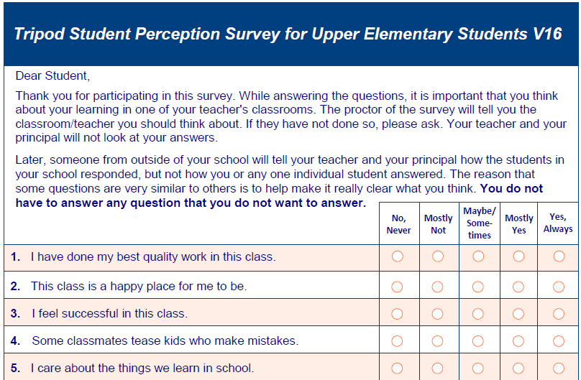
Format of the Tripod Surveys
Notes:
Students will complete the surveys in a paper-based format. For each item, there are 5 response options. Students can make any mark in the bubble.
That is, they DO NOT need to fill in every part of the bubble.
The survey takes a class period to complete and completion rates of over 90% are common.

Slide 25
Sample Survey Items
Care
Confer
Captivate
Clarify
Control
Students in this class treat the teacher with respect.
My classmates behave the way the teacher wants them to.
Our class stays busy and doesn’t waste time.
Consolidate
Challenge
Control

Slide 26
Sample Survey Items
Care
Confer
Challenge
Captivate
My teacher asks students to explain more about the answers they give.
My teacher doesn’t let people give up when the work gets hard.
In this class, we learn to correct our mistakes.
My teacher wants us to use our thinking skills, not just memorize things.
Clarify
Consolidate
Challenge
Control

Slide 27
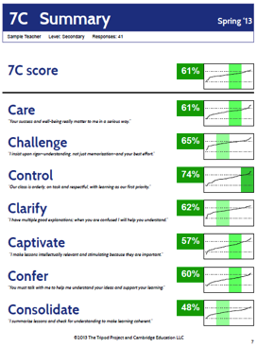
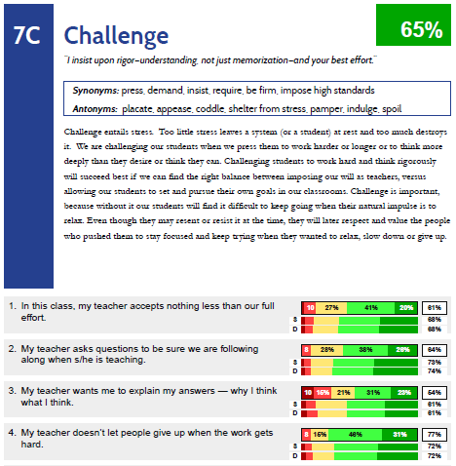
Moving from Ideas to Action
Surveys are organized to help focus goal-setting discussions and decisions about professional development.
Notes:
In the past several years thousands of teachers have received Tripod survey results and used this information as part of their goal setting for professional growth.
Reports are delivered directly to teachers and include data from the surveys and also guidance about how to interpret and use the results.

Slide 28
A Case Study in Collecting Student Feedback American Youth Policy Forum March 27, 2014

Slide 29
Lewiston, Maine
2nd largest city in Maine ~ 38,000 people

Slide 30
Lewiston - a service center for Maine
Area | Lewiston | Maine
Home language other than English | 20.6% | 7.0%
Bachelors degree or higher (Age25+) | 14.6% | 27.1%
Mean Household Income | $37.102 | $46.033
Children under 18 yrs. in poverty | 32.2% | 19.0%
Children aged birth to 5 yrs. in poverty | 43.4% | 21.4%

Slide 31
Lewiston Public Schools
5500 students
68% free and reduced lunch
22% English Language Learners
Six pre-kindergarten to grade 6 schools
One middle school
One high school
One Regional Vocational Technical Center

Slide 32
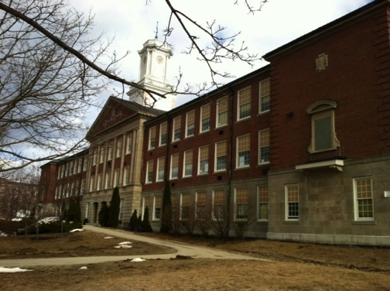
Lewiston Middle School
670 Students
Grades 7 and 8
22% English Language Learners
16 % Special Education

Slide 33
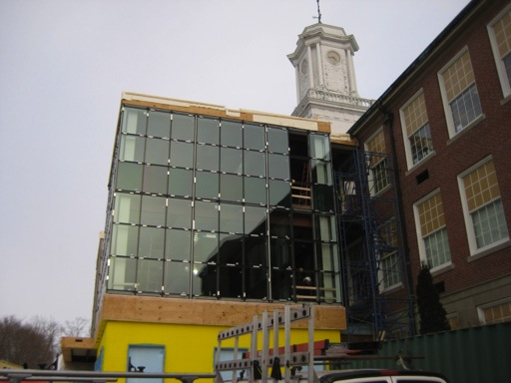
LMS Under Construction

Slide 34
Lewiston Middle School
Team structure with common team time
1:1 Technology
Working to increase math and reading proficiency
Extensive after school and summer programs

Slide 35
So what happens when you tell staff that you are going to collect feedback from students that will be viable to them and to their administrators?

Slide 36
History
Teacher Incentive Fund (TIF) Grant
January 2011
5 year period beginning July 2010
Ends September 2015

Slide 37
Goals of TIF
Improving student achievement by increasing teacher and principal effectiveness
Reforming teacher and principal compensation systems so that teachers and principals are rewarded for increases in student achievement
Increasing the number of effective teachers teaching poor, minority, and disadvantaged students in hard-to-staff subjects
Creating sustainable performance-based compensation systems

Slide 38
How does student opinion fit into this?

Slide 39
National Board for Professional Teaching Standards
Teacher recognizes individual differences in his/her students
Teacher demonstrates an understanding of how students learn
Teacher treats students equitably and fosters a stimulating and collaborative environment…

Slide 40
Lewiston’s Approach
2011-2012
Focused on using results as part of National Board work
Used administration to focus on logistic processes
Low stakes

Slide 41
2012-2013
Trained teachers through teacher leadership
Shared cumulative data for staff analysis
No impact on “scorecards”
Teachers had more respondents
National and local data used to set targets for local use

Slide 42
District and National Averages
Early Elementary
Date | Challenge | Captivate | Control | Clarify
LPS 2012 | 77.7% | 69.3% | 57.4% | 80.1%
LPS 2013 | 81.1% | 72.4% | 61.7% | 83.6%
National Decile | 6th | 6th | 6th | 7th

Slide 43
District and National Averages
Elementary
Date | Challenge | Captivate | Control | Clarify
LPS 2012 | 72.3% | 61.0% | 50.1% | 79.3%
LPS 2013 | 78.3% | 61.1% | 55.0% | 79.9%
National Decile | 5th | 5th | 8th | 5th

Slide 44
District and National Averages
Grades 7-12
Date | Challenge | Captivate | Control | Clarify
LPS 2012 | 67.1% | 57.9% | 55.8% | 66.3%
LPS 2013 | 71.4% | 61.2% | 61.2% | 67.8%
National Decile | 6th | 7th | 8th | 6th

Slide 45
Challenges
Logistical
Challenging populations
Technology
Perceived accuracy
Too many surveys

Slide 46
Added Values
Teacher reflection
Professional development
Teachers digging more deeply into the data
Student voice
Driving individual and school change

Slide 47
Changes we’ve made
Better professional development, inclusion in New Teacher Induction
Including school cumulative results as in administrator evaluation
An alternate survey for instructional staff who do not work directly with students
Encouraging staff to consider results in their professional goal setting
Comparable administrator survey by staff

Slide 48
Concerns to still address
Length and reading level of the 7-12 survey
English Language Learners
Actual cost
Time to schedule and arrange
Teachers in nontraditional settings
Need for students to take survey multiple times

Slide 49
www.lewistonpublicschools.org
www.cambridgeeducationgroup.com
Presenters
Karen P Paquette, Assistant Principal
Lewiston Middle School
kpaquette@lewistonpublicschool.org
Susan B Martin, Chief Academic Officer
Lewiston Public Schools
smartin@lewistonpublicschools.org

