Slide 1
Audience Questions?
@CCRSCenter
@AYPF_Tweets
#AcceleratedEd

Slide 2
Building Capacity for Quality:
The Role of NACEP Accreditation

Slide 3
Notes:
In reflecting on the issues confronting education today, it's important to step back in time with a bit of a history lesson and quiz. Can anyone identify this visually imposing example of gothic architecture (Joliet Township High School)
Now that we've identified the building, can anyone tell me its historical significance? It is the birthplace of the public community college – back in 1901 the University of Chicago and Joliet High School partnered to establish Joliet Junior College. At the time when postsecondary education was reserved for the elite few – 2% of the college-age population – this innovation created an academic mirror of the first two years of coursework at the University of Chicago for students who wished to pursue a college education in their home community.
The University leadership saw rapid change coming, with increased numbers of middle class families demanding higher education for their kids. They came up with this new model to support student transitions – and in a symbolic way created the ultimate pathway for students to navigate the transition from high school to college: walk up a flight stairs. For the first six decades of its existence, Joliet Junior College was located on the upper floors of the high school.
I think there are many parallels to today when you consider the remarkable growth and demographic shift in the student populations enrolled in both secondary and postsecondary education.
I'll leave it to the historians to investigate whether Joliet Junior College was the first in the nation to offer what we now refer to as dual credit; today Joliet continues its commitment to creating seamless educational pathways for students across our segmented education systems.
Our history lesson takes us next to the University of Connecticut and Saint Louis University in the 1950s, which both established partnerships with local high schools to offer what NACEP now defines as concurrent enrollment: college credit-bearing courses taught by college-approved high school teachers.
Concurrent enrollment continued to emerge in isolated locations around the country in the 1970s (Syracuse, Vincennes, etc.). By the early 1980s a cluster of programs had developed in pockets around the country: in Missouri, Indiana, Utah, New York, Minnesota, and Washington State. In the late 80s and early 90s we began to see a few of these states (Minnesota, Utah, Virginia, Arkansas) enacting statewide policies that encouraged more institutions to develop programs.
The model really began to take off in most places in the mid-1990s; in many instances in conjunction with the growth of Tech Prep programs that established career tech consortia.
A survey done in the mid-1990s of Chief Academic Officers about partnerships with high schools inventoried approximately 200 dual or concurrent enrollment programs nationwide. Within a decade, NCES estimated that nearly 2,000 postsecondary institutions (55%) offered some form of dual or concurrent enrollment in 2002-03. This has plateaued, because 96% of community colleges now offer dual or concurrent enrollment.

Slide 4
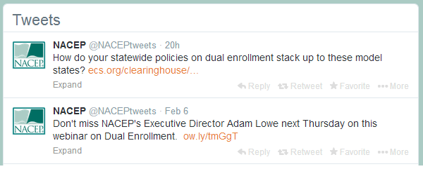
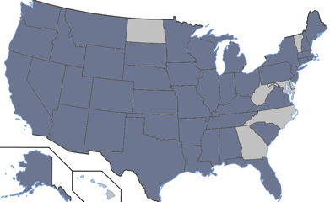
Research
Communications
Governmental Relations
Membership in 42 States
Conferences/Professional Development
Notes:
Long established programs sought each other out in the late 1990s; meeting on the sidelines of other higher education conferences starting in 1997 which resulted in the formal establishment of NACEP in 1999.
One of the concerns of the founders of NACEP in the late 1990s was the quality of the programs being created during a rapid expansion in the number of institutions offering concurrent enrollment courses. Our national standards were adopted in 2002 after two years of dialogue among the 2-3 dozen members in NACEP at that time. In 2004, the first cohort earned accreditation after peer review. The standards were revised in 2009 after extensive electronic consultation with the membership and discussion at our conferences.
There are now currently 83 programs nationwide accredited by NACEP, with 15 additional programs currently undergoing initial accreditation review (will be voted on in April).
NACEP's primary focus is on concurrent enrollment, and the accreditation process is restricted solely to the concurrent enrollment model. As a membership organization, we embrace dialogue and sharing of research and best practices on all dual enrollment delivery models. Virtually all of our 250 member postsecondary institutions in 38 states offer multiple opportunities for high school students to earn college credit.

Slide 5
Location of dual enrollment By numbers of students participating
Source: National Center for Education Statistics, Dual Credit and Exam-Based Courses in U.S. Public High Schools, February 2013.
Notes:
Secondary locations includes career centers run by the public school system. The prevalence of this non-traditional course location – at the high school campus – warrants added academic oversight from postsecondary institutions.
While the NCES reports’ definitions don’t enable us to get precisely at NACEP’s definition of concurrent enrollment, it is the most prevalent course delivery model. Of high schools offering dual enrollment, 51% teach at least one academic course at a secondary school location; at 89% of these schools, high school instructors deliver some or all of the college courses.
From the postsecondary perspective, 64% of postsecondary institutions with dual enrollment programs offered courses at high school campuses in 2010-12; only 55% did so in 2002-03. 45% percent of postsecondary institutions with courses offered at high school campuses utilize high school instructors to teach at least some of those courses.

Slide 6
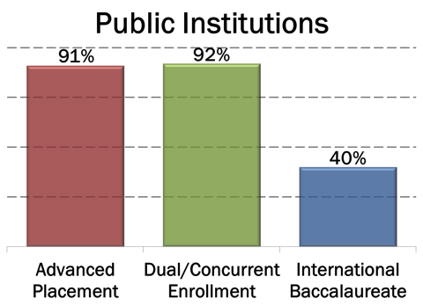
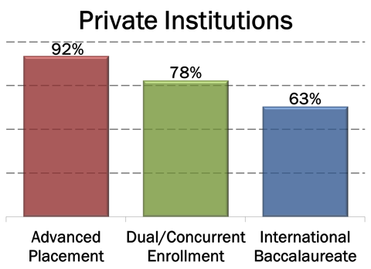
Credit is Widely Accepted
Source: Western Interstate Commission for Higher Education, Accelerated Learning Options: Moving the Needle on Access and Success, June 2006.
Notes:
Upholding standards is thus a vital factor in credit acceptance and transfer among colleges and universities, and acceptance of dual and concurrent enrollment.
Now despite the headlines I showed above, broadly speaking concurrent enrollment is accepted widely and transfers well. Our accredited programs do followup surveys of student alumni, and most report transfer rates over 90% or higher.
This national study looked at credit acceptance, both for required or elective credit. It was a survey of chief academic officers. But national statistics mask the variation in acceptance. What we have seen is that is imperative that concurrent enrollment providing institutions must demonstrate the academic integrity of their credits to gain the trust of credit receiving institutions. Illinois is a good example of this – the University of Illinois was placing added restrictions on dual credit transfer until the community colleges demonstrated that their programs met a set of quality standards. And it required them to collectively approach the University to articulate what those standards were.
A number of states (Indiana, Wisconsin, Minnesota, Iowa, Utah, Florida, for example) require that public postsecondary institutions accept dual credit in the same fashion as they would any other transcripted credit. In states without such policies (Michigan, Virginia) – the flagship, doctoral-granting institutions often use the lack of quality or standards as an excuse to impose added restrictions. NACEP provided a research grant to the University of Connecticut for a 2013 followup study on credit transfer to collect more recent data and begin assembling a national database of information on credit acceptance policies.

Slide 7
Higher Education Accreditation
Types of higher education accrediting organizations:
Regional accreditors
National faith-related accreditors
National career-related accreditors
Programmatic accreditors
Notes:
To understand NACEP’s role as an accreditor, it's important to understand the quality assurance system used by higher education institutions in the U.S. There are 7,300 institutions of higher education; 4,500 of which are degree-granting institutions – the others tend to be career colleges focused on only one or a few specific certificate programs.
Some of the features of the US higher education system not seen in other countries with more centralized systems include:
Diverse missions that differentiate institutions
A high value placed on intellectual freedom
Entrepreneurial and adaptable
Compared to other countries, very limited state involvement in:
Curriculum
Instruction
Faculty
Assessment
U.S. higher education system is premised on a belief that institutions have primary responsibility for academic quality – generally speaking our state governments do not write or approve curricula, examine the credentials of faculty, or review the performance of students.
The primary means by which colleges, universities and programs monitor quality in the US is third-party, peer-review accreditation carried out by private, nonprofit organizations.
Regional accreditors. Accredit public and private, mainly nonprofit and degree-granting, two- and four-year institutions
National faith-related accreditors. Accredit religiously affiliated and doctrinally based institutions, mainly nonprofit and degree-granting.
National career-related accreditors. Accredit mainly for-profit, career-based, single-purpose institutions, both degree and non-degree.
Programmatic accreditors. Accredit specific programs, professions and freestanding schools, e.g., law, medicine, health professions, engineering, etc. This is the category in which NACEP falls.

Slide 8
NACEP Standards: Guiding Principles
A high quality concurrent enrollment program (CEP) is one where:
College courses offered in high schools are as rigorous as courses offered on the sponsoring college campus
CEP students are held to the same expectations and standards of achievement as on campus students
CEP instructors meet the same requirements for on campus adjunct instructors, and are provided support by faculty in their discipline
CEP program oversight is sufficient to ensure the academic integrity of its courses, regardless of where they are taught and by whom
Notes:
While our standards are prescriptive in a number of ways, they also have proven to be flexible enough to accommodate a wide range of institutional structures.
FACULTY, ASSESSMENT, CURRICULUM, STUDENTS, PROGRAM EVALUATION
Courses: Such as syllabus, assessment methods, expectations of learning, course philosophy
Students: Such as registration & add/drop policies; course prerequisites; grading scales
Instructors: Departments only approve faculty if they would hire them to teach on campus; provided course-specific training prior to teaching; annual discipline-specific professional development
Institutional oversight: Site visits, tracking of instructor participation, program evaluation, transcripting

Slide 9
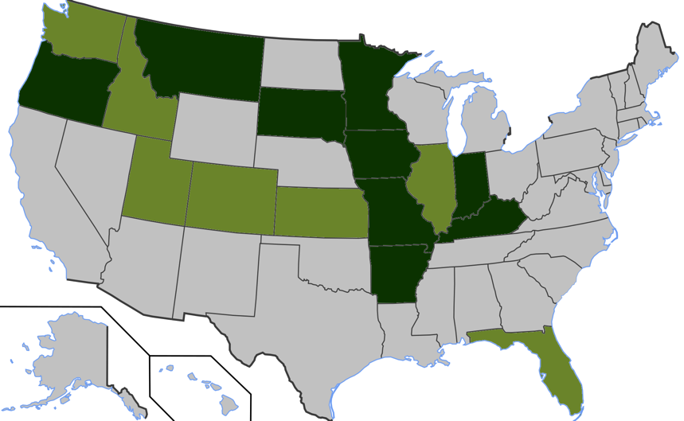
Quality Standards: NACEP in State Policy
■ ~ State standards modeled on NACEP standards
■ ~ State requires or incentivizes NACEP accreditation
Notes:
Course and Program Quality
A 2013 report commissioned for the Higher Learning Commission found some elements of state policy provisions related to the quality for postsecondary providers of dual and concurrent enrollment in 42 states. The most common relate to instructor eligibility and selection, and course rigor, and transcripting requirements. The standards vary across the states, but a common intent lies behind these standards – that college courses offered to high school students are of the same high quality and rigor as the courses offered to matriculated college students.
As the only national set of standards of excellence for concurrent enrollment partnerships, NACEP’s standards serve as a model for statewide quality standards in 16 states.
Nine of these states require or encourage colleges and universities to obtain NACEP accreditation.
NACEP did a 2010 study on state oversight mechanisms. Institutions can choose their poison – a collegial peer review by experts in the field from out of state with no vested interest (NACEP) or a state review conducted either by bureaucrats or representatives of other institutions in the state with a vested interest.
Regional accreditors have been starting to pay attention to concurrent enrollment. SACS for the past few years; and the new HLC criteria that just came into effect for the first time explicitly address dual credit. A recent report commissioned by HLC highlighted NACEP’s leadership in this area.
Professional associations have likewise looked to NACEP’s standards and accreditation when concerns arise over concurrent enrollment course quality. Two collegiate divisions of the National Council of Teachers of English have endorsed NACEP accreditation.

Slide 10
Adam I. Lowe, Executive Director
alowe@nacep.org
919-593-5205
www.nacep.org

