Slide 1
Dual Enrollment: The Role of Policy in Promoting Quality Pathways to Postsecondary Success
February 13, 2014
@CCRSCenter
@AYPF_Tweets
#AcceleratedEd
Technical Support:
1-800-263-6317
Notes:
Welcome to today’s webinar entitled Dual Enrollment: The Role of Policy in Promoting Quality Pathways to Postsecondary Success.
co-sponsored by the College and Career Readiness and Success at AIR and the American Youth Policy Forum. My name is Joe Harris and I am the Director of the CCRS Center.
First, a few logistical points:
In the event of any technical difficulties; you may dial 1-800 263 6317 to reach GotoWebinar’s technical support line. Also, if you happen to lose connectivity, please go ahead and log back into the webinar.
At any point during the webinar you may type your questions for our presenters in the “Questions” box on your screen and we’ll do our best to answer them after the presentations. Please be sure to identify if the question is for a particular panelist.
We will be live tweeting today’s webinar and encourage you to do the same using the hashtag: #AcceleratedEd
Finally, please note that the slides and a recording of today’s session will be available on the CCRS Center and AYPF’s websites

Slide 2
Introduction and Overview
Joseph R. Harris, Ph.D.
Director, CCRS Center
@CCRSCenter
@AYPF_Tweets
#AcceleratedEd

Slide 3
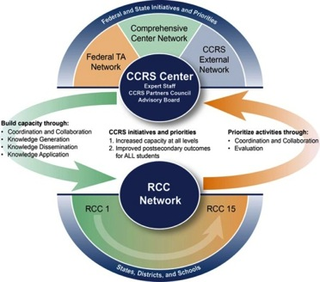
CCRS Center Technical Assistance Hub Task Areas
Coordination and Collaboration
Regional Comprehensive and Content Centers
Federal CCRS Technical Assistance Providers
External CCRS Stakeholders and Resources
Knowledge Development and Application
New CCRS Center Products and Tools
CCRS Knowledge Database
Webinars and Symposia
CCRS Center Website and Social Media
Responsive and Proactive Technical Assistance
Networked Communities
#AcceleratedEd
Notes:
For those of you who are new to our webinar series, the College and Career Readiness and Success Center, which is housed at the American Institutes for Research, is part of a network of federally funded comprehensive centers that provide technical assistance and resources to our regional partners and the states they serve on key educational reform issues. The American Youth Policy Forum, our co-host, is a lead partner of the CCRS Center. As a CCRS technical assistance hub, we collaborate with federal and external centers and resource providers to promote knowledge development, dissemination and application through technology-based activities such as this webinar today.

Slide 4
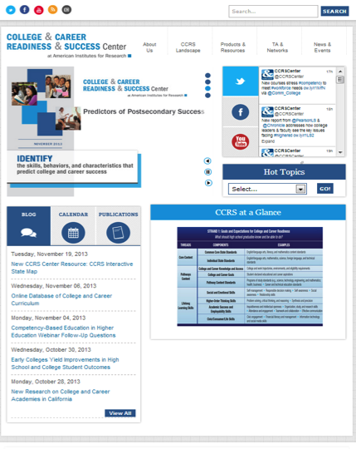
Visit our website: ccrscenter.org
#AcceleratedEd
Notes:
We invite you to visit our website to access a copy of this webinar and to learn more about other CCRS resources and activities that may be of interest to you and your colleagues.

Slide 5
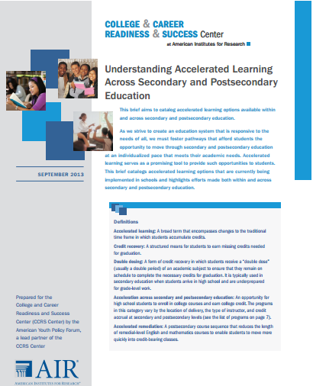
CCRS Center Brief: Understanding Accelerated Learning Across Secondary and Postsecondary Education
#AcceleratedEd
Notes:
Over the past few months, the CCRS Center has been exploring and sharing information and tools around accelerated learning options, starting with this brief released last November.
The brief aims bring some clarity to use of the term acceleration by focusing on research-supported strategies both within and across secondary and postsecondary education that allow students to accelerate their learning and thus build momentum towards long-term success.

Slide 6
CCRS Center Prior Webinars on Accelerated Learning
Understanding Accelerated Learning Across Secondary and Postsecondary Education - http://www.ccrscenter.org/products-resources/ccrs-center-webinars-events#sthash.Ydu3qTu9.dpuf
Early College, Early Success: Program Overview, Research Findings, and Implications for Practice - http://www.ccrscenter.org/products-resources/ccrs-center-webinars-events#sthash.Ydu3qTu9.dpuf
#AcceleratedEd
Notes:
In addition, we have held a three part webinar series on accelerated learning in collaboration with AYPF, culminating with today’s webinar. Previous webinars in broadly discussed the use of acceleration in secondary and postsecondary to create flexible, personalized learning opportunities for students and considered specific models of practice. Today’s webinar focuses on the role of state policy to help build, develop, and sustain high quality dual enrollment, an acceleration strategy operating across secondary and postsecondary education.
To address terminology confusion with often plagues discussions of acceleration across secondary and postsecondary education, today’s webinar will use term “dual enrollment” to refer to any opportunity for a high school student to enroll in college course. Thus, dual enrollment includes college courses taught at any location, any delivery modality, any instructor-type, and regardless of whether or not they receive high school credit. Our presenters, when necessary, will identify when they are referring to a specific model under the broader umbrella of dual enrollment.

Slide 7
Today’s Presenters
Jennifer Dounay Zinth, Senior Policy Analyst, Education Commission of the States (ECS)
Adam Lowe, Executive Director, National Alliance of Concurrent Enrollment Partnership (NACEP)
John Fischer, Deputy Commissioner, Vermont Agency of Education
Joyce Judy, President, Community College of Vermont
Moderator: Jennifer Brown Lerner, American Youth Policy Forum
@CCRSCenter #AcceleratedEd
Notes:
I am going to briefly introduce today’s presenters in the order they will be speaking. Please know that following each presentation we will have an opportunity for clarifying questions, so we encourage you type them into the question box through the webinar. For questions not addressed during today’s webinar, we will do our best to either connect you with the presenter or post responses on the CCRS Center blog.
Our first presenter will be Jennifer Dounay Zinth, a Senior Policy Analyst at Education Commission of the States. She will be sharing information from ECS’ recently updated database on dual enrollment policy as well as their recently released brief on model policy components.
Jennifer will be followed by Adam Lowe, Executive Director of the National Alliance of Concurrent Enrollment Partnerships,
John Fischer, Deputy Commissioner of the Vermont Agency of Education and Joyce Judy, President of the Community College of Vermont will share their state’s experience in supporting and expanding high quality dual enrollment pathways. They will speak both about the legislative role and the capacity building efforts across secondary and postsecondary institutions.
Our question and answer period will be moderated by Jennifer Brown Lerner of the American Youth Policy Forum, a lead partner in the CCRS Center.
To begin our webinar, I will turn it over to Jennifer Dounay Zinth.

Slide 8
Dual Enrollment:
Where We Are and Model Policy Components
Jennifer Dounay Zinth
Education Commission of the States
Equipping Education Leaders, Advancing Ideas

Slide 9
About ECS
National organization based in Denver, CO
Non-partisan, nonprofit
Funded by state fees, grants/contracts, corporate support
Cover the P-20 spectrum
Primary constituents = state-level education leaders in 50 states, D.C. and territories:
Governors
Legislators
Chiefs and state boards
Postsecondary leaders

Slide 10
Overview
ECS database on dual enrollment
Trends in state-level dual enrollment policy
ECS brief on model components of dual enrollment policy

Slide 11
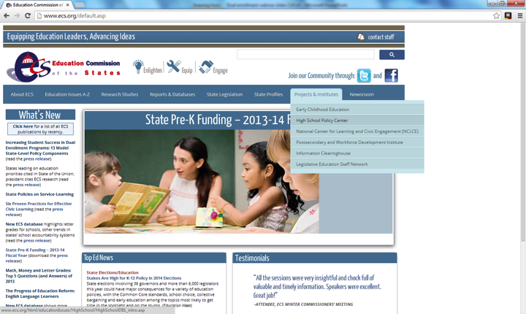
Dual Enrollment Database
Accessible from www.ecs.org

Slide 12
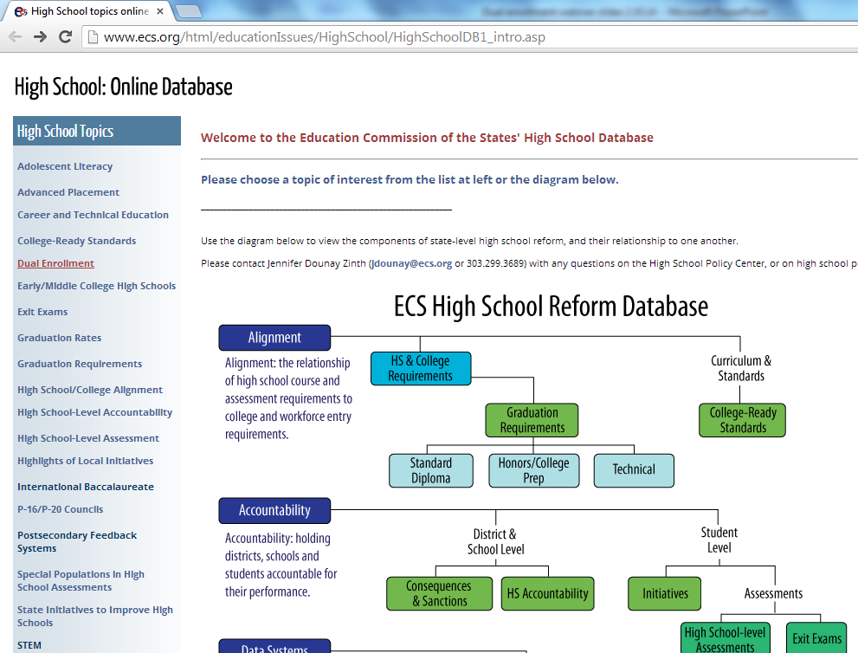
Dual Enrollment Database

Slide 13
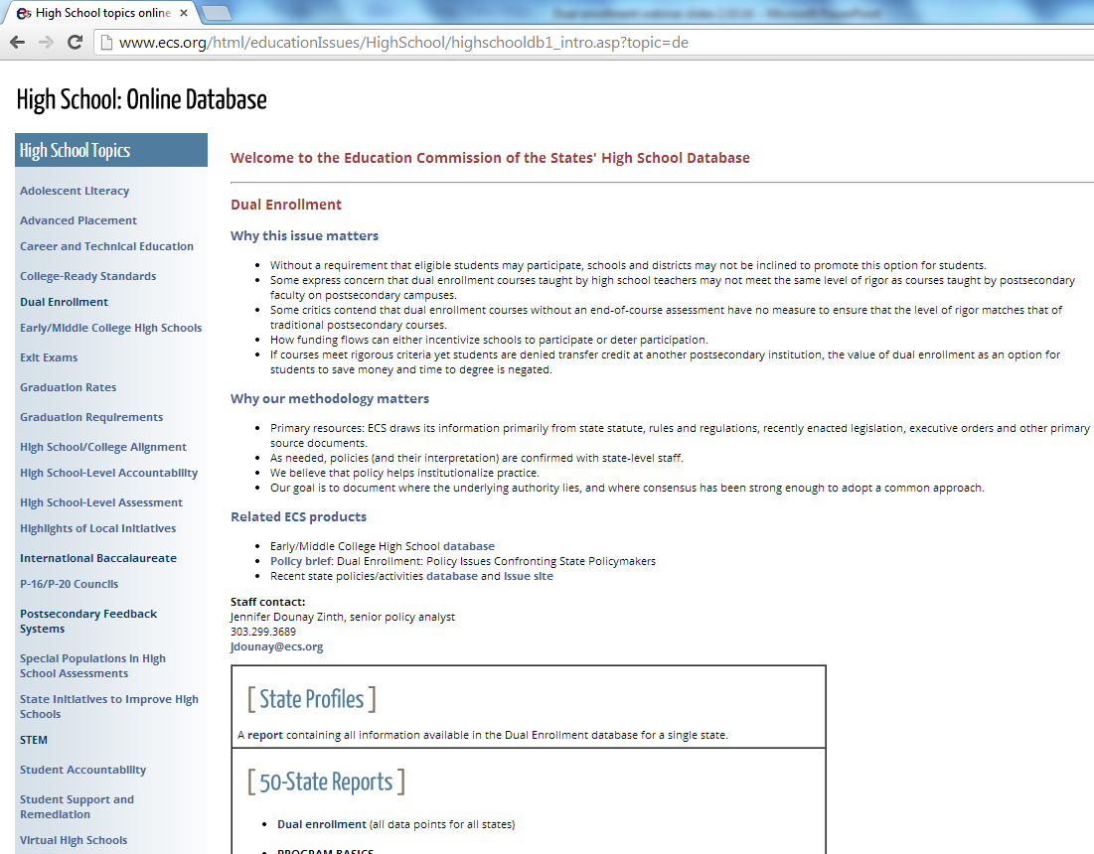
Dual Enrollment Database

Slide 14
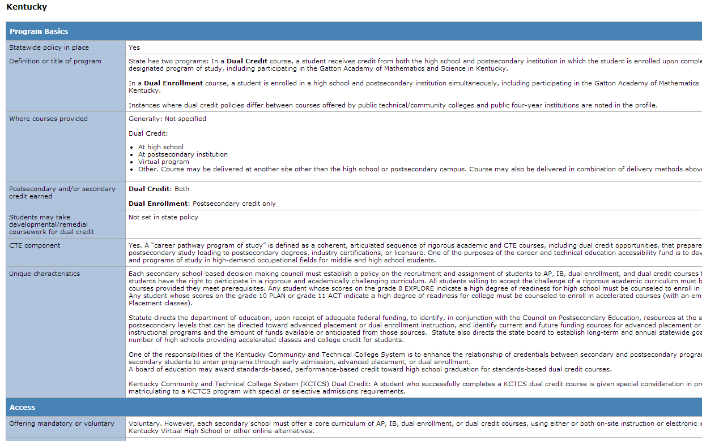
Dual Enrollment Database

Slide 15
Dual Enrollment Database
View all data points for all states + DC or
all 50 states + DC across a single data point.

Slide 16
Trends 2008-2013
Notification
Quality
Reporting
Evaluation

Slide 17
Notification
You can’t go if you don’t know.
Traditionally underserved students less likely to be aware of program, program benefits.
No meaningful policy movement 2008-2013
Same 20 states both years

Slide 18
Quality
If academic integrity is compromised, everyone’s time and money is wasted.
Measures of instructor/course quality vary across states
Teachers become adjunct faculty
Same syllabus, course materials, grading practices, etc.
Institutions/faculty provide training, orientation, professional development
Courses reviewed to ensure fidelity to postsecondary standards
Teachers evaluated in same manner as traditional faculty

Slide 19
Quality
Positive growth from 2008-2013
2013: 37 states have embedded instructor/course quality components in state policy!
2008: 29 states (28% increase 2008-2013)
Policies added in CO, GA, HI, MN, NV, TN, WA, WY

Slide 20
Reporting
Program evaluation impossible without good data
Positive growth from 2008-2013
2013: 30 states have integrated reporting requirements in state policy!
2008: 18 states (67% increase 2008-2013)
Huge variation across states in data that must be reported

Slide 21
Evaluation
Evaluation helps states maximize “bang for their buck”
Evaluation measures vary across states:
Student participation/outcomes data must be evaluated
Policy permits entity to submit recommendations for policy changes
Local plan must provide for regular program evaluation

Slide 22
Model Policy Components

Slide 23
Model Policy Components
Database and policy brief combined can help policymakers and educators to determine if policies in their state contribute – or provide unintentional barriers – to program access and quality.

Slide 24
Model Policy Components
Access
All eligible students are able to participate.
Student eligibility requirements are based on the demonstration of ability to access college-level content.
Caps on the maximum number of courses students may complete are not overly restrictive.
Students earn both secondary and postsecondary credit for successful completion of approved postsecondary courses.
All students and parents are annually provided with program information.
Counseling is made available to students/parents before and during program participation.

Slide 25
Model Policy Components
Finance
7. Responsibility for tuition payments does not fall to parents.
8. Districts and postsecondary institutions are fully funded or reimbursed for participating students.

Slide 26
Model Policy Components
Ensuring Course Quality
9. Courses meet the same level of rigor as the course taught to traditional students at the partner postsecondary institution.
10. Instructors meet the same expectations as instructors of similar traditional postsecondary courses, and receive appropriate support and evaluation.
11. Districts and institutions publicly report on student participation and outcomes.
12. Programs undergo evaluation based on available data.

Slide 27
Model Policy Components
Transferability
13. Postsecondary institutions accept dual enrollment credit as transfer credit, provided measures of quality are ensured.

Slide 28
New from ECS in 2014
March: CTE in dual enrollment brief
Two additional briefs to be published later in 2014
State data elements project
Session at 2014 National Forum on Education Policy
DC, June 30-July 2
Update of 2013 dual enrollment database?
And as always:
Monitoring legislative and regulatory enactments
Answering information requests
Providing presentations, testimony, technical assistance

Slide 29
Education Commission of the States
700 Broadway, Suite 810
Denver, Colorado 80203
(303) 299-3624
www.ecs.org
ecs@ecs.org

